Slide 1

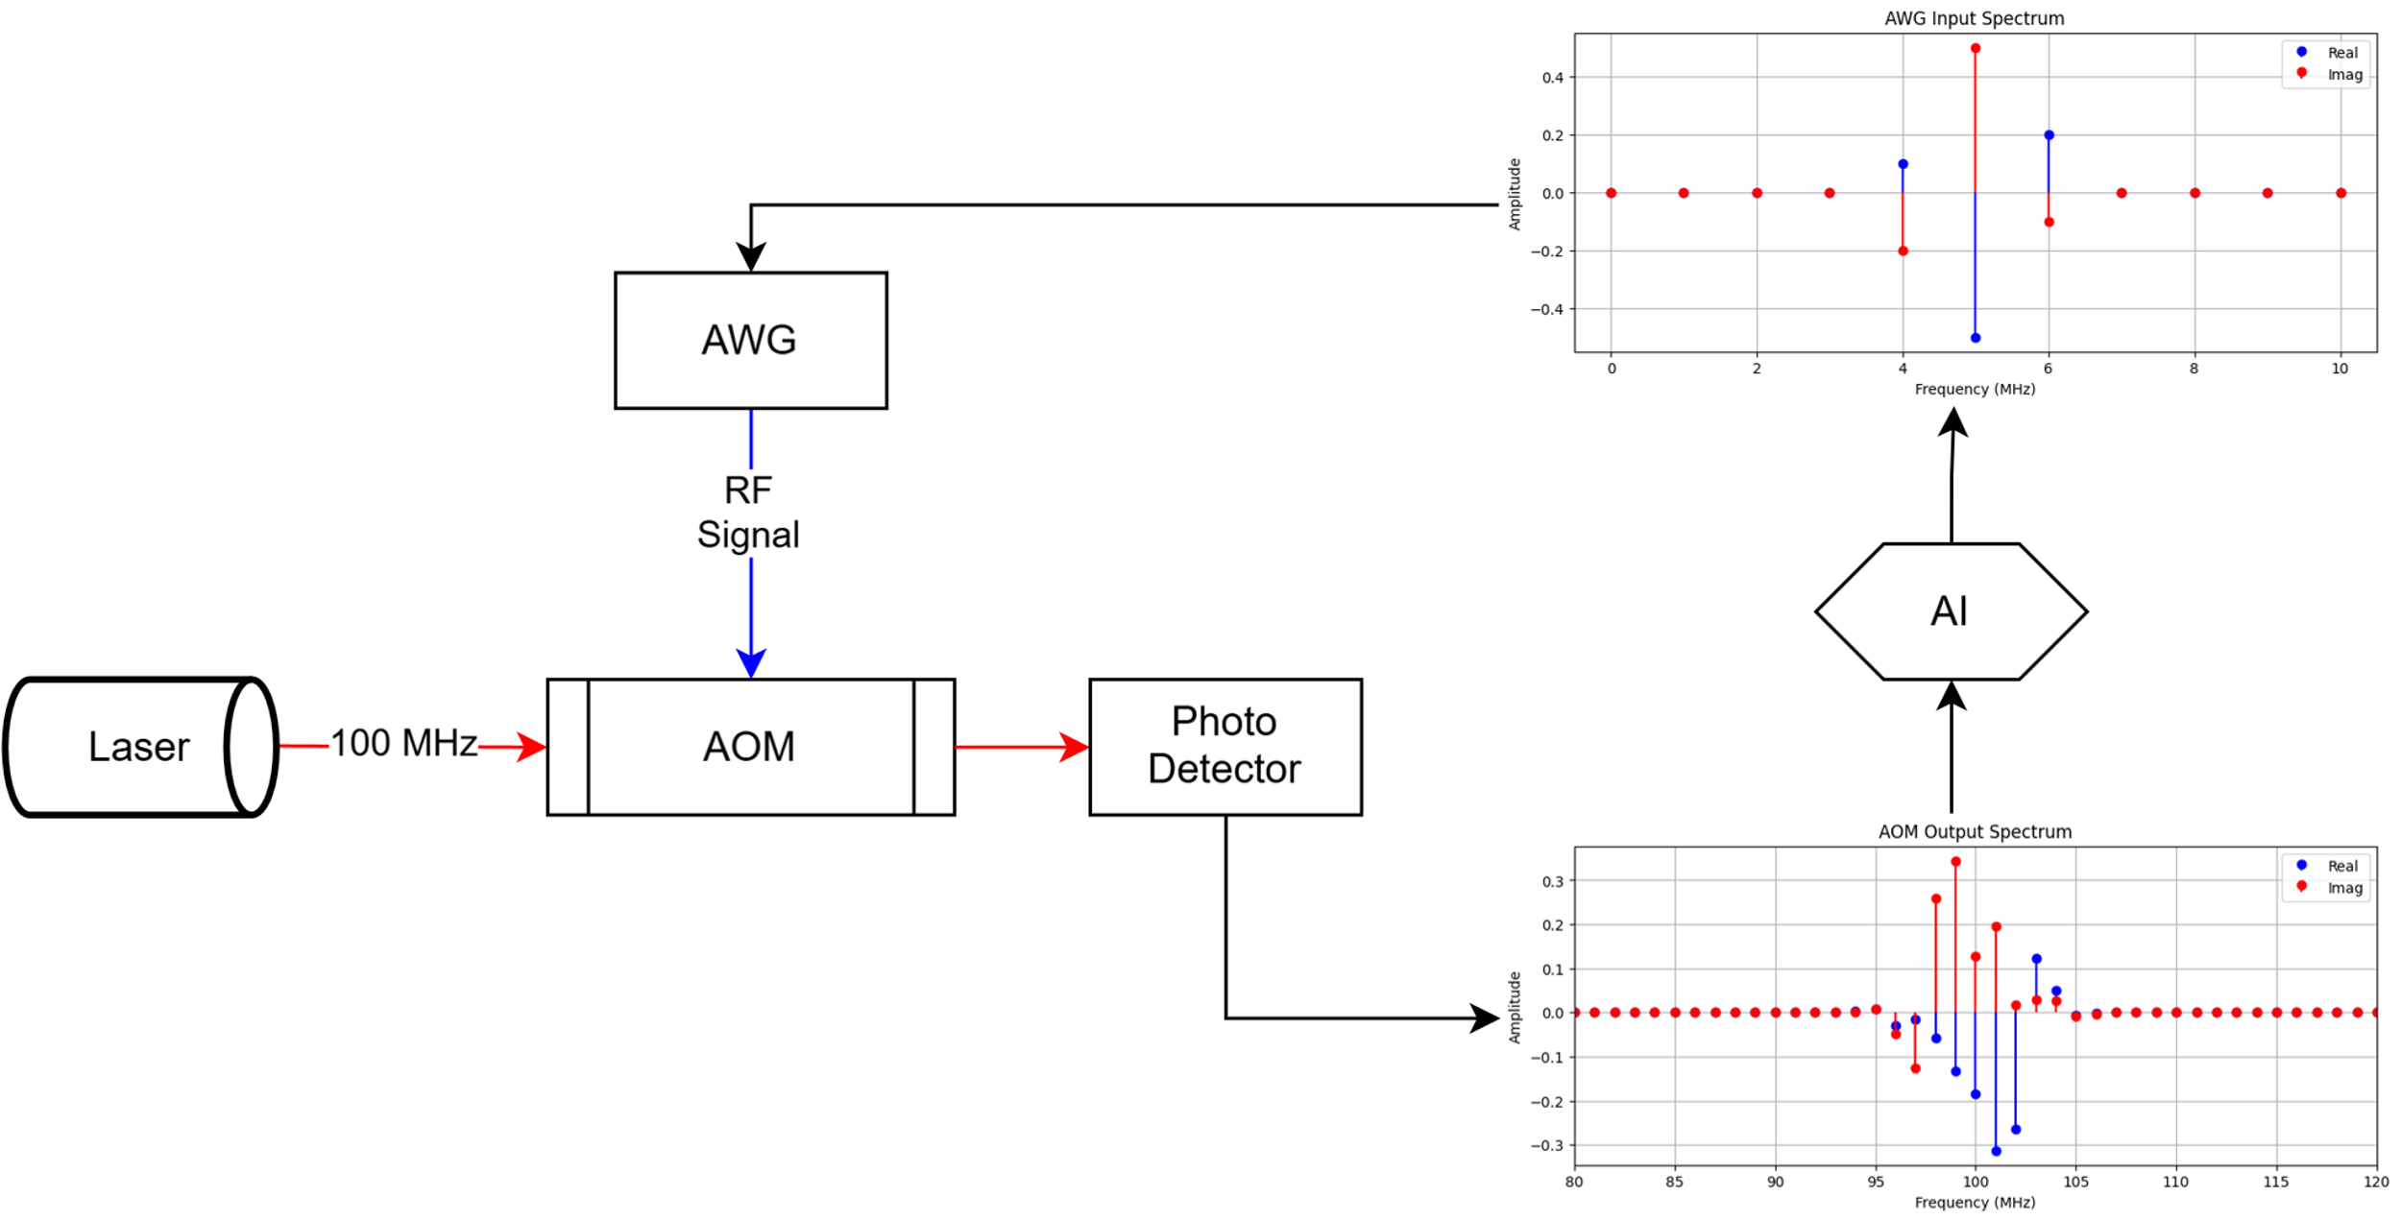
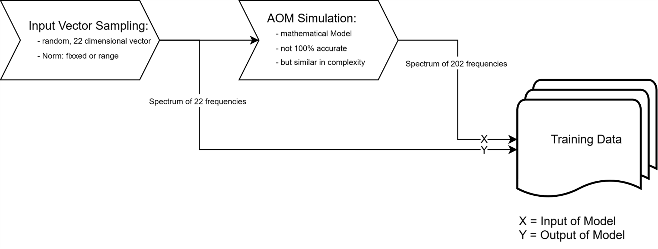
DSAI Project Seminar
Intelligent AOM
Project Doner: Dr. Prof. Eschner & Team (Experimental Physics – Quantum Photonics)
Leo Forster & Jonas Henker
Introduction
In the experimental setup the spectrum of an incoming laser beam is changed in an acousto-optical modulator (AOM) by interfering with an applied radio frequency (rf) signal coming from an arbitrary wave generator (AWG).
We want to predict the frequency spectrum given to the AWG by modeling the resulting frequency spectra given a desired, complex output spectrum which should be then produced by the AOM.
Experimental Setup
Motivation
For experiments in the field of quantum photonics concrete frequency spectra are needed often. Controlling those as desired via the predictions of the required AWG configurations given by our model, works handy and saves a lot of time.
Due to nonlinear and complex input-output relationships can not be computed in the real world but learned by machine learning methods and then predicted accordingly.
Objectives setup_simple.drawio
Find a suitable model able to predict the required AWG input spectra given the desired AOM output spectra and observe the impact of different hyperparameters, changes in the simulation & non-linearity on the model performance.
Using both the simulated AOM output spectra as input and the sampled AWG input spectra as desired output, we train the model.
Data Processing *could be removed*
*whatever is listed under (2)*
Model Architecture *pls reformulate*
Brief summary or diagram (e.g., MLP, CNN, etc.)
What makes the model suitable for nonlinear mappings?
Performance metrics or comparison between models.
Results *pls reformulate*
Example input/output spectra from model
Comparison of predicted vs. actual AOM spectra
Error metrics, learning curve, etc.
(1)
Bildunterschrift: Fuckin explain the image what the fuck
Data Processing
Bildunterschrift: Each AWG input spectrum has 11 real valued & 11 complex valued frequencies ranging from 95 to 105 mHz.
Similar, each AOM output spectrum has 101 real valued & 101 complex valued frequencies ranging from 50 to 150 mHz.
The training data is generated without noise or missing values.
For this we sample the potential AWG input spectra by randomly selecting points on the surface of a 22-dimensional sphere, ensuring that the norm is constant. The AOM output is obtained by simulating the AOM using a complexity similar mathematical model.
Using both the simulated AOM output spectra as input and the sampled AWG input spectra as desired output, we train the model.
INSERT RESULTS AS IMAGES IDFK

